Slide 1
Computing Fundamentals
Elements of a Personal Computer

Slide 2
Elements of a Personal Computer
The elements of personal computer system:
The equipment itself (computer, monitor, printer, etc.) is called HARDware because you can physically touch the components.
Programs are called SOFTware as they function only while the computer is on. A software program is a set of coded instructions the computer uses in a series of on/off signals to carry out the user’s task.
These on/off signals begin when you first turn on the computer. Without electricity the computer cannot function.

Slide 3
Elements of a Personal Computer
The four major hardware component parts called internal or external devices that make up the system include:
Central processing unit (CPU)
Input/output (I/O) devices
Random access memory (RAM)
Storage devices
An internal device installs inside the system unit, and an external device plugs into a connection on the computer.

Slide 4
System Unit
The system unit or box is often the most important and expensive part of the computer. A desktop box or a tower box provides the same functionality.
Separate devices inside the box perform specialized functions for the computer:
• Motherboard
• Microprocessor
• Power Supply
• Expansion slots

Slide 5
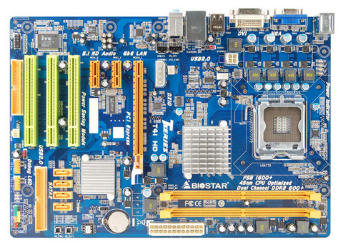
System Unit
Motherboard

Slide 6
System Unit
Motherboard
– largest electronic circuit board and consists of the CPU, RAM, and ROM BIOS.
– any smaller circuit boards plugged into prefabricated expansion slots are called daughterboards.
– expansion slots expand your computer by adding items such as graphics video card
– peripheral component interconnect (PCI) slots add new components or cards such as a modem
– input/output ports are connectors for various input or output devices such as USB mouse
– accelerated graphics port (AGP) slot is for a card that can handle 3-D graphics
– central processing unit (CPU) slot contains the microprocessor chip
– random access memory (RAM) slot is designed for these types of memory chips
– system clock determines time and date as set in the BIOS and runs on battery

Slide 7
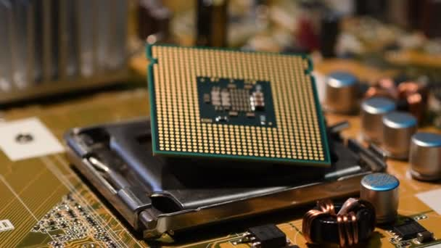
System Unit
Microprocessor
– “Brain” of the computer, located on the motherboard; also known as the central processing unit (CPU)
– Instructions from the software programs and the user are received and executed here
– Each model or type processes information and instructions at speeds measured in megahertz (MHz) or gigahertz (GHz):

Slide 8
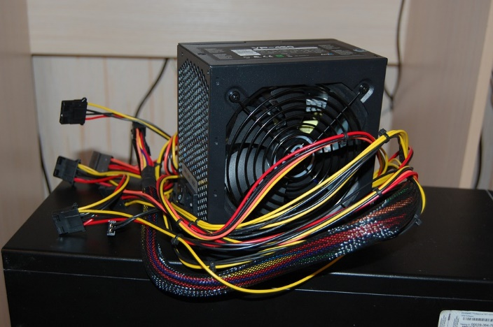
System Unit
Power Supply
Power supply converts the AC (alternating current) coming from a wall outlet to DC (direct current) format
Must be between 5v and 12v, with 5v needed for the circuit boards and 12v for hard drives and CD-ROMs

Slide 9
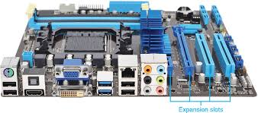
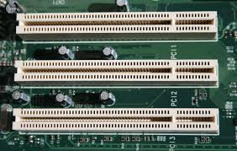
System Unit
Expansion slots
The openings at the back of a system unit, to allow you to add items such as sound cards, printers, network cards, etc.

Slide 10
Memory
For a computer to store information, it needs to have memory chips installed. Memory is measured in bytes; in very simple terms, one byte is equal to one character.
Officially, computers are developed using a numbering system of 1s and 0s. These two unique numbers represent the charged or uncharged nature of electricity and are known as the binary system.
These two digits essentially make a bit and eight bits make one byte.

Slide 11
Memory
The following shows how computer technology and the requirement for storage capacity have grown:
Size in “bytes”
1 Kilobyte (KB) = 1,024
1 Megabyte (MB) = 1,048,576
1 Gigabyte (GB) = 1,073,741,824
1 Terabyte (TB) = 1,099,511,627,776
1 Petabyte (PB) = 1,125,899,906,842,624

Slide 12
Memory
All data processed in a computer is made up of bytes, in various combinations as calculated by the computer.
Every file used in a software program by the computer has a specific file size, based on the instructions for that feature.
The larger the file is, the more memory you will need to process the information in the file and to store the file. Even if a file is not being stored on the computer, it still requires memory to process it.

Slide 13
Memory
Read Only Memory Basic Input/Output System (ROM BIOS)
– a group of integrated circuits responsible for starting the computer, checking RAM, and loading the operating system
– occurs only when the computer is first turned on or when you have to restart the computer.
– does not perform any tasks other than to read the information and process it based on the device.

Slide 14
Memory
Random Access Memory (RAM)
– located on the motherboard
– electronic pool of memory where the computer can hold programs and data
– RAM temporarily holds the current software program and the current data created by the user
– RAM is volatile – it only works when the computer is turned on and the information “vanishes” when the computer is turned off.

Slide 15
Memory
Cache Memory
– helps speed up the processor by storing frequently used instructions and data in this area.
– Dynamic RAM (DRAM) constantly changes, using what it needs based on the instructions being performed, and constantly “refreshes” itself.
– Static RAM (SRAM) is a specific amount of RAM that never needs to be refreshed, and is traditionally faster and more reliable.

